Slide 1
Real-time speaker Recognizer
Offline and real-time
speaker diarization system
Author: Hao Pan Supervisor: Dr. Beta C.L. Yip

Slide 2
Agenda
Introduction
Literature review: Focus & Gap
Objectives
Offline system
Real-time system
Runtime analysis

Slide 3
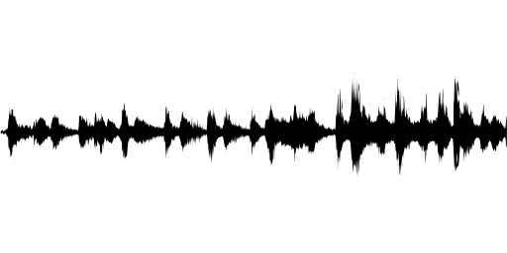
Introduction - Speaker diarization
Speaker diarization: partition an input audio stream into homogeneous segments according to speaker identity
Answer question “who spoke when”
2 Types:
Offline:
Access the whole audio;
perform clustering after all segments are registered
Online:
Strict left-to-right fashion
Speaker 2
Speaker 3
Speaker 1
Speaker 1
Speaker 4

Slide 4
Problems in existing system
Literature review
Main research direction:
3 domains: Telephone conversation, meeting, broadcast news
Aims at improving the accuracy
Offline diarization
Train the model that is effective in speaker recognition, and use to speaker diarization
Lack of real-time system
Require Intensive computation & long processing time
Online diarization performance are worse than offline diarization
Many system are domain-specific

Slide 5
Objectives
Develop a speaker diarization system:
[Offline Version]: label the speakers in a recorded audio and visualize the results
[Real-time Version]: generate outputs as the input is analyzed and correct the earlier output when necessary
[Other requirements]:
Language-independent;
domain-robust;
Platform-independent;
Do not need prior training

Slide 6
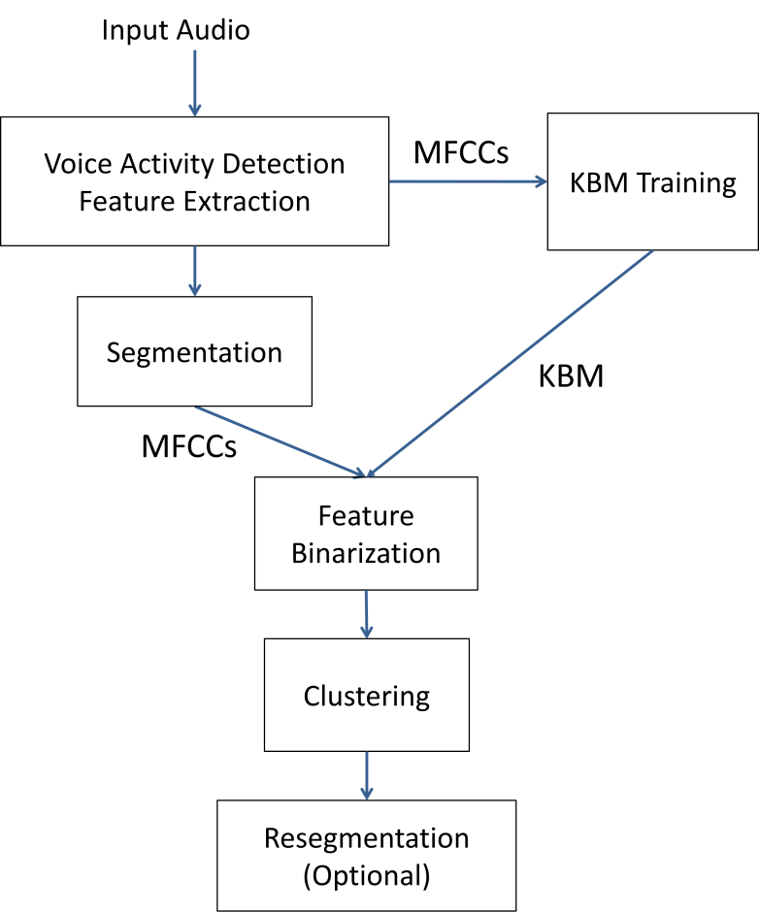
System workflow (offline) adopt binary key speaker modelling
Train MFCC to obtain KBM that model the acoustic space of the audio
Transform the vector of features of segments or clusters into Cumulative Vector (CV) which is used as the representation of segments or clusters

Slide 7
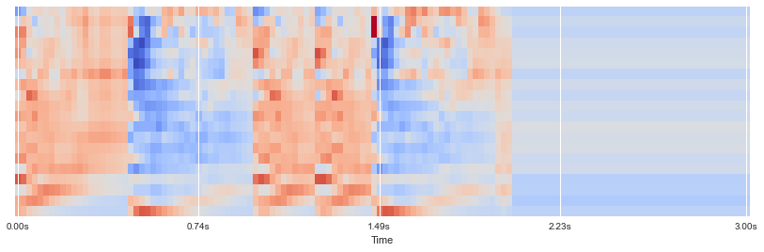
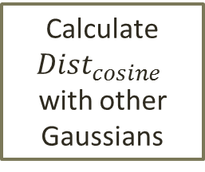
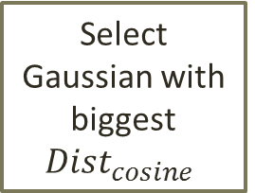
KBM Training
Features (MFCCs)
Speaker acoustic space
Sliding Windows
KBM
……
Gaussian
Pool
most complementary & discriminant Gaussians
……
Stop when getting N Gaussians
Select 1st Gaussian with max likelihood
Calculate ${Dist}_{cosine}$
with other Gaussians
Select Gaussian with biggest ${Dist}_{cosine}$

Slide 8
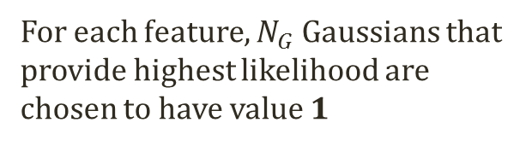
Feature representation
Features of utterance
(segments)
m features vectors
Cumulative Vector (CV)
Binary Key (BK)
Count
Occurrences
0
1
0
1
0
1
0
0
15
1
0
0
1
7
1 for top 20% values in CV
0
N Gaussians
in KBM
0
1
……
0
3
0
1
0
1
25
1
0
1
0
5
0
…
…
…
…
1
0
1
17
1
For each feature, $N_{G}$ Gaussians that provide highest likelihood are chosen to have value 1
Segment/cluster
representation

Slide 9
Advantages of the system
Fast
Require no training data
Domain-robust
Offline
Disadvantage

Slide 10
Runtime analysis: offline system
Intel® Core™ i5-4200U CPU @ 1.60GHz 2.30GHz & Windows 8.1
Audio from 1 min – 50 min (with 1 min resolution)
Real-time factor = runtime / audio duration

Slide 11
Runtime analysis: offline system
Components | Average Real-time factor | Runtime of 10 min audio
VAD | 0.0013 | 0.750s
Feature extraction | 0.0015 | 1.016s
Segmentation | < 1e-5 | 0.016s
KBM Training | 0.0014 | 0.622s
Compute representation for all features | 0.013 | 7.614s
Offline Clustering | 0.0015 | 0.578s
Resegmentation | 0.0046 | 2.700s
Total | 0.023 | 13.30s
Fast enough for fixed-size recorded audio
Not fast enough for real-time audio stream that new data is inputed
→ Any components can run on new data only?

Slide 12
Design of real-time system
Offline
Thread 1
Thread 2
All Data
KBM Training
Compute representation for all features
Offline clustering
KBM
CVs
MFCCs
KBM
Results
VAD,
Feature extraction
Compute representation for new features
Online clustering
New
MFCCs
CVs
New Data
Online

Slide 13
Thread 1
Thread 2
All Data
KBM Training
Compute representation for all features
Offline clustering
KBM
CVs
MFCCs
KBM
Results
VAD,
Feature extraction
Compute representation for new features
Online clustering
New
MFCCs
CVs
New Data
1 thread to run KBM training & compute features representation
1 thread to run offline clustering
Need 10-15s audio data to train the first KBM → No result
The used KBM may not be updated for the new data → delay in KBM training
The final results are consists of result from offline clustering (major part) and result from online clustering (the most recent seconds)

Slide 14
Experiment on real-time system
To Simulate the Real-time processing using recorded audio:
Data is fed to the system every 1s
Diarization result is generated (and visualized) for every 1s
At time t, the system can only access the data of the audio up to time t and is required to generate diarization result within 1s
Every 1s
Recorded audio
1s Data
Real-time Diarization system
Result

Slide 15
Real-time system: KBM delay
The used KBM may not be updated for the new data → The acoustic features are not reflective in KBM → delay in detecting new speaker
At time t2, if we use KBM that is updated at t1 (t1<= t2), KBM_delay = t2 – t1

Slide 16
Real-time system: Online
Results : offline for major data + online for new data
How many second of the results are from the online clustering?

Slide 17
Main contribution
Build a speaker diarization system with visualization and audio player panel
Design and develop a real-time speaker diarization system on the basis of the offline system
Future works
The problem of frequent change of the number of speakers in real time system need to be further solved
Find the better offline & online clustering approach that incorporates previous output
Parameters of KBM training need be further determined for real-time cases
The system need to be further improved in terms of speed and audio processing for real-time streaming data

Slide 18
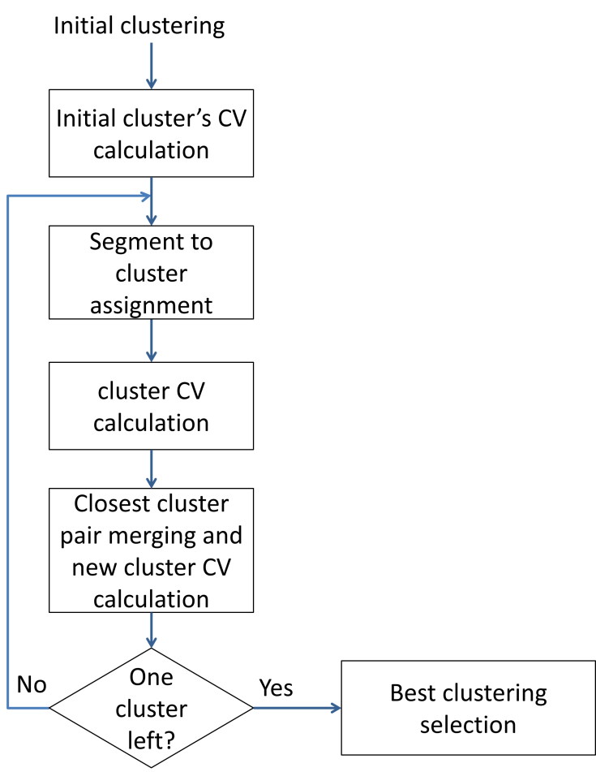
agglomerative hierarchical clustering (AHC)

Slide 19
Every 1s
Recorded audio
1s Data
Real-time diarization system
Result

Slide 20
Speaker diarization system
Speaker 2
Speaker 3
Speaker 1
Speaker 1
Speaker 4

Slide 21



$$T=0$$
$$T=t_{1}$$
$$T=t_{2}$$
Labels from offline clustering
Labels from online
clustering

